Slide 1
Data Exploration Analysis on Store Sale Data
Andrew Pickard-Christen, Johanna Chen, Dang Minh Nhu Nguyen, Le Dao
Dr. Martina Bremer
Notes:
(10-15 min presentation)
Pretend you’re talking to an employer who has asked you about this project in your portfolio during an interview. Why did you choose this project? Which methods did you implement? Did you write your own code or used code from somewhere? Talk about the methods you used.
Show us a description of your code or algorithm (or Pseudocode if you like) rather than actual code. If your analysis contained several different steps, walk your audience through those steps. Definitely show the results of your work in graph or table form.

Slide 2
Motivation
Objective
How do holidays, transactions, and oil prices affect each other?
Data on transactions and holidays in Ecuador
Ecuador is a culturally rich and festive country, and they observe many holidays
Analyze how holidays, cities, transactions, and oil prices affect each other from 2013 to 2017.
Notes:
Why did you choose this project?
From the beginning, we decided to work on a data wrangling project. We originally chose a dataset based on manager salary; however, because there was only one dataset available, we needed at least one other dataset. In addition, there were many columns with free-form text data that would be difficult to work with.
Alternatively, we chose another dataset called Store Sales-Time Series Forecasting. We chose 4 files to work with, containing information about holiday events, stores, transactions, and oil. There was missing data on the oil file but none others.
Explain the information in each dataset.

Slide 3
Data Cleaning
Package: Pandas, matplotlib, plotly, seaborn
Data Merging: Merge Left to reduce data loss
Merge left result in lots of NAs
Missing data are from different type so, use Multiple Imputation by Chained Equation
MICE: Imputes missing data into a dataset through an iterative series of predictive models

Slide 4
Methods (cont.)
Goal 1: The trend of average transactions in each city throughout different holiday type
Method 1: Group the data by city and holiday and aggregated the average transaction
Goal 2: Is the trend of average transactions above being affected by the number of stores that each city had?
Method 2: Group the data by city and value_counts() the number of stores
Notes:
Discuss the task of merging the files together.
Then the specific question you addressed.
Show us a description of your code or algorithm (or Pseudocode if you like) rather than actual code. If your analysis contained several different steps, walk your audience through those steps.

Slide 5
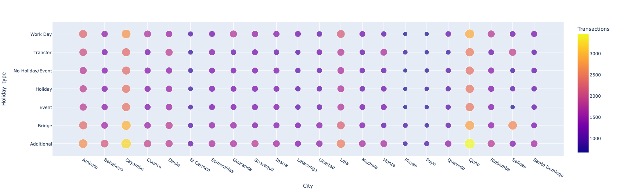
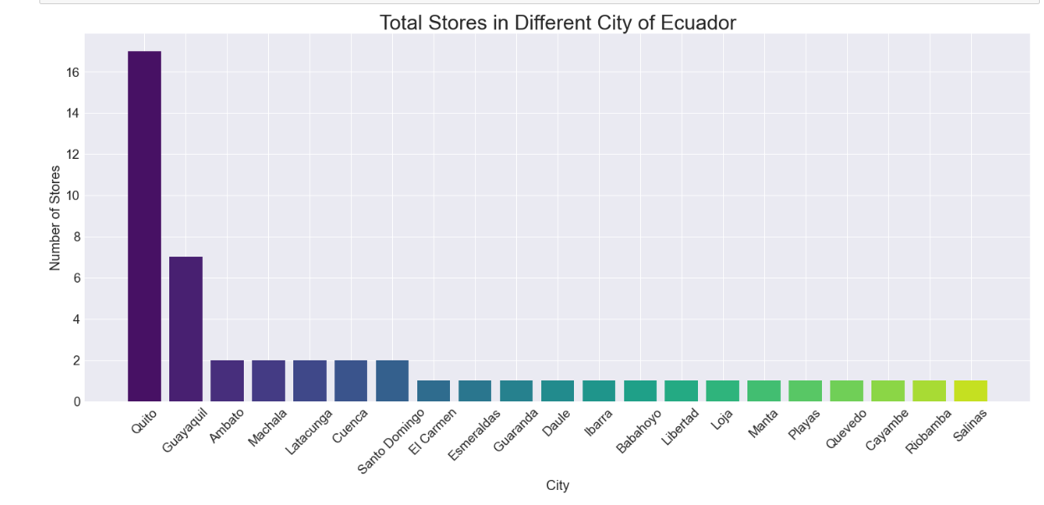

Slide 6
Methods (cont.)
Goal: Investigating the store has highest transactions separated by type of Holidays (i.e. Local, Regional, National) .
Future Goal: predict the store sale during each type of holidays for better service and supply.
Data Exploration: 17 cluster groups separated by type of product they were selling (i.e. Beverages, Bakery, Clothing…)
Summary Cluster Groups and Store Number (extracted)
Cluster group | Store Number | Type of Product
1 | 24, 25, 27 | Beverages, bakery, books,...
6 | 9, 11, 20, 21, 34, 39 | Beauty, beverages, automotive, baby care,…
12 | 17 | Personal care, pet supplies, ladies wear…
14 | 46, 47, 48, 50 | Celebration, bakery, pet supplies,...
16 | 18 | Automotive, prepared food, produce,...
17 | 51 | Baby care, automotive, poultry,...
Notes:
Kat: The next goal that our group want to accomplish is investigating which store has highest transactions separated by type of Holidays (i.e. Local, Regional, National). One of the benefit of completing this goal, in the future, we can predict the store sale so that we can have better preparation in service and supply
To achieve this, we need to first explore the data, according to Kaggle, we able to find out the type of product they were selling. Here are the output for some of them.
Since we were interested in the total transactions which were separated by type of holidays (i.e. Local, National, Regional), the choice of stacked bar plot would be meaningful in this case.
Discuss the specific question you addressed.
Show us a description of your code or algorithm (or Pseudocode if you like) rather than actual code. If your analysis contained several different steps, walk your audience through those steps.

Slide 7
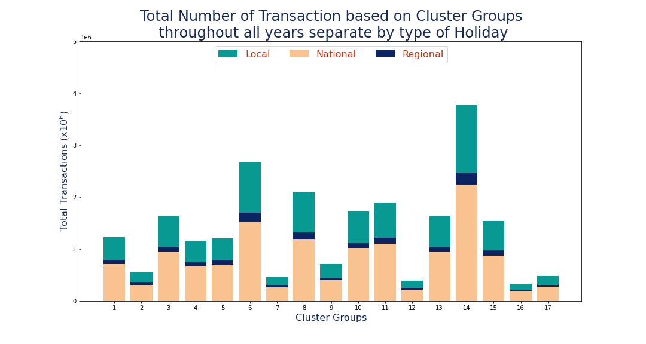
Results
Highest transaction groups: cluster group 14
Lowest transaction groups: cluster group 12, 16, 17
Deeper Analysis on group 14:

Slide 8
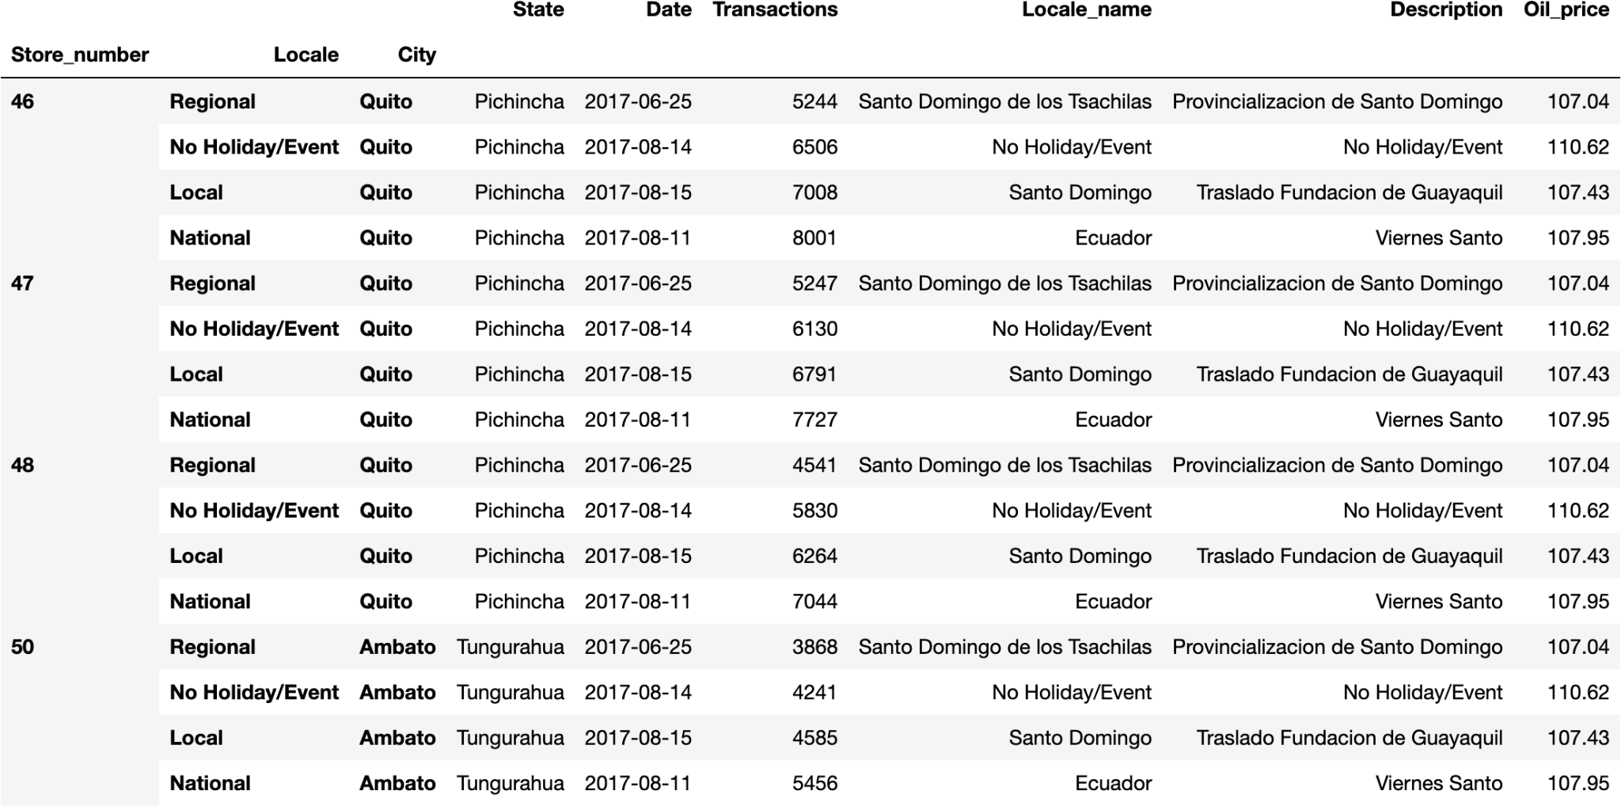
Results
Highest transaction groups: cluster group 14
Lowest transaction groups: cluster group 12, 16, 17
Deeper Analysis on group 14:
Location: Quito City
Regional Holiday: Provincialización de Santo Domingo (06/25/2017)
National Holiday: Viernes Santo (08/11/2017)
Local Holiday: Traslado Fundación de Guayaquil (08/15/2017)
People shopped ahead
No correlation between Oil Price and Transaction

Slide 9
Methods (cont.)
Goal: Investigate the relationship between the price of crude oil over the year it was sold using a box plot.
It will be able to be used to predict the average future oil prices, given the range of prices from the previous year.
The data was cleaned by inputting averaging values to replace missing data. The final year only contains a partial year’s worth of data.
Notes:
Discuss the specific question you addressed.
Show us a description of your code or algorithm (or Pseudocode if you like) rather than actual code. If your analysis contained several different steps, walk your audience through those steps.

Slide 10
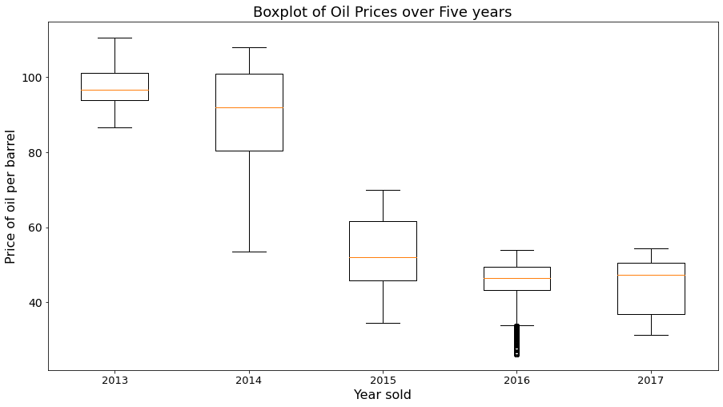
Results
The graph shows a significant downturn in the price of oil from 2014 to 2015, one which did not recover in the following years and even worsened going into 2017.
The crash is attributed to an oversupply of oil with respect to demand in the previous years, which led to prices being at their lowest in years.
Notes:
Show the results of your work in graph or table form.

Slide 11
Methods (cont.)
Goal: compare consumer behavior during the holiday season to normal working days
Computed sum of transactions for all holidays and non-holidays
Notes:
Johanna’s Slide
Discuss the specific question you addressed.
Show us a description of your code or algorithm (or Pseudocode if you like) rather than actual code. If your analysis contained several different steps, walk your audience through those steps.

Slide 12
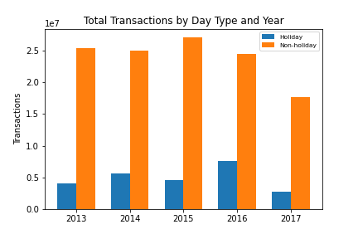
Results
~ 1 to 5 ratio of holiday vs. non-holiday transactions
Graph may be deceptive (too data reliant)
Dataset observes 105 distinct holiday dates and 328 distinct non-holiday dates
Notes:
Compare behavior of consumers between holidays and non-holidays across different years.
In total, consumers make less total transactions during holidays… graph suggests ~1 to 5 ratio of holiday transactions versus non-holidays transactions
Graph may be deceptive (too reliant on our specific data that it does NOT reveal info about the true proportion of transactions in Ecuador
To give some perspective of our data, I identified the unique dates in our dataset that we considered a holiday and those that were non-holidays. Ratio: 1 to 3 (105 distinct holiday dates and 328 distinct non-holiday dates recorded).

Slide 13
Conclusion
In summary, we were able to use the information provided by the data set to predict future trends and draw conclusions on the current situation.
The data cleaning process we used was able to accurately represent the data in a simple and understandable way. The data we found was useful and we were able to learn a lot about the country of Ecuador and their patterns of crude oil consumption.

